Slide 1

Basic Details of the Team and Problem Statement
Ministry/Organization Name/Student Innovation: Blockchain and cybersecurity
PS Code: SIH1451
Problem Statement Title: Develop a AI/ML tool to detect whether a
system / firewall /router / network is compromised. The technique should not rely only on IoCs detection.
Team Name: Hack Hive
Team Leader Name: Mugunth.D
Institute Code (AISHE): U-0474
Institute Name: Sathyabama Institute of Science & Technology
Theme Name: CyberGuard: Intelligent IoC Discovery System

Slide 2
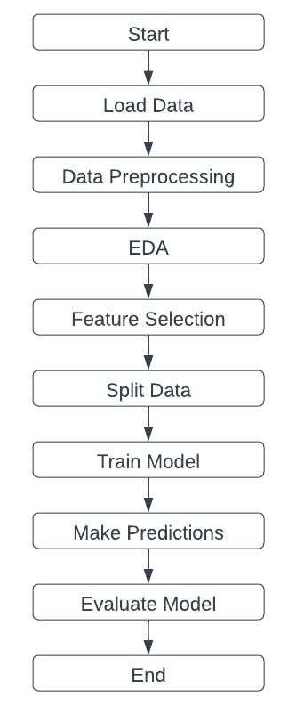
Idea/Approach Details
Describe your idea/Solution/Prototype here:
The system gathers information from various sources such as threat feeds, blogs, and dark web forums to compile a comprehensive database of potential threats.
Instantaneous notifications empower rapid responses to new and unusual IoCs, bolstering security against emerging threats.
Describe your Technology stack here:
Programming Languages (Python)
Machine Learning and Natural Language Processing (TensorFlow, PyTorch, NLTK, spaCy)
Web Technologies (Django, Flask, React, Angular, Vue.js)
Data Storage (Relational and NoSQL Databases)
Youtube Video link: https://youtu.be/duFejokbDoE

Slide 3
Idea/Approach Details
Describe your Use Cases here
Describe your Dependencies / Show stopper here
Early Threat Detection and Mitigation
Automated Incident Response Capabilities
Proactive Vulnerability Management Solutions
Collaborative Threat Intelligence Sharing
Continuous Monitoring for Anomalies
Efficient Phishing Campaign Analysis
Authentic Data Sources are Essential.
Access to the internet continuously is crucial.
Making Sure of Accuracy for Trustworthy Data Analysis.
Monitoring ongoing system performance.
Ethical operation is ensured by legal compliance.

Slide 4
Team Member Details
Team Leader Name: Mugunth.D
Branch : B.E Stream : CSE Data science Year : IV
Team Member 1 Name: Sukesh Raghav.G
Branch : B.E Stream : CSE Artificial Intelligence Year : IV
Team Member 2 Name: Sanjay Krishna.S.R
Branch : B.E Stream : CSE Year : IV
Team Member 3 Name: Sriram.R
Branch : B.E Stream : CSE Artificial Intelligence Year : IV
Team Member 4 Name: Yuthika.P
Branch : B.E Stream : CSE Artificial Intelligence Year : IV
Team Member 5 Name: Swetha.R
Branch : B.E Stream : CSE Artificial Intelligence Year : IV
Team Mentor 1 Name: Dr.Cruz Antony.J
Category : Academic Expertise (AI/ML/Blockchain etc): AI & ML Domain Experience (in years): 4
Team Mentor 2 Name: Dr.Jeslin Shanthamalar
Category : Academic Expertise (AI/ML/Blockchain etc): AI & ML Domain Experience (in years): 7

